Slide 1
What Unit testing and Integration testing
Mr. Amitava Chatterjee

Slide 2


















What is Unit Testing
Unit testing involves the testing of each unit or an individual component of the software application.
The purpose is to validate that each unit of the software code performs as expected
Unit testing is done during development (coding phase) of an application by the
developers
Unit may be a an individual function, method, procedure, module and object
Employee Service
Employee Repository
Employee Controller
MySQL

Slide 3
What is Unit Testing
In Java, JUnit framework is used for unit testing Java applications
Most of the times one component will depend on other component(s), so while implementing unit tests we should mock the dependencies with the desired behaviour using frameworks like Mockito.

Slide 4















Integration Testing
As the name suggests, integration tests focus on integrating different layers of the application. That also means no mocking is involved.
Basically, we write integration tests for testing a feature which may involve interaction with multiple components.
Employee Service
Employee Repository
Employee Controller
DB
Examples:
Employee Management Feature ( EmployeeRepository, EmployeeService, EmployeeController).
User Management Feature (UserController, UserService, and UserRepository).
Login Feature (LoginRespository, LoginController, Login Service) etc

Slide 5
Unit Test Naming Conventions
Mr. Amitava Chatterjee

Slide 6









Unit Test Naming Conventions
1. MethodName_StateUnderTest_ExpectedBehavior:
isAdult_AgeLessThan18_False
withdrawMoney_InvalidAccount_ExceptionThrown admitStudent_MissingMandatoryFields_FailToAdmit
2. MethodName_ExpectedBehavior_StateUnderTest
isAdult_False_AgeLessThan18
withdrawMoney_ThrowsException_IfAccountIsInvalid admitStudent_FailToAdmit_IfMandatoryFieldsAreMissing

Slide 7








Unit Test Naming Conventions
3. test[MethodName]:
testSaveEmployee
testGetEmployeeById testUpdateEmployee
4. test[Feature being tested]
testFailToWithdrawMoneyIfAccountIsInvalid testStudentIsNotAdmittedIfMandatoryFieldsAreMissing

Slide 8




Unit Test Naming Conventions
5. Should_ExpectedBehavior_When_StateUnderTest:
Should_ThrowException_When_AgeLessThan18
Should_FailToWithdrawMoney_ForInvalidAccount Should_FailToAdmit_IfMandatoryFieldsAreMissing
6. When_StateUnderTest_Expect_ExpectedBehavior:
When_AgeLessThan18_Expect_isAdultAsFalse
When_InvalidAccount_Expect_WithdrawMoneyToFail When_MandatoryFieldsAreMissing_Expect_StudentAdmissionToFail

Slide 9






Unit Test Naming Conventions
7. givenPreconditions_whenStateUnderTest_thenExpectedBehavior:
givenEmployeeObject_whenSaveEmployee_thenReturnSavedEmployee
givenEmployeesList_whenFindAll_thenReturnListOfEmployees givenEmployeeObject_whenUpdateEmployee_thenReturnUpdatedEmployee givenEmployeeEmail_whenFindByEmail_thenReturnEmployeeObject givenInValidEmployeeEmail_whenFindByEmail_thenReturnEmployeeObject
In this course, we use this naming Convention - given/when/then

Slide 10
Understanding Spring boot starter test dependency

Slide 11
Spring boot starter test dependency
The Spring Boot Starter Test dependency is a primary dependency for testing the Spring Boot Applications. It holds all the necessary elements required for the testing.
This starter includes:
Spring-specific dependencies
Dependencies for auto-configuration
Set of testing libraries - JUnit, Mockito, Hamcrest, AssertJ, JSONassert, and JsonPath.

Slide 12
Spring boot starter test dependency
When using this starter, we don't need to update the versions of all the dependencies (JUnit, Mockito, Hamcrest, AssertJ, JSONassert, and JsonPath) manually. The Spring Boot parent POM handles all dependency versions, and the Spring Boot team ensures the different testing dependencies work properly together.

Slide 13
AssertJ Overview
Mr.AMITAVA CHATTERJEE

Slide 14
AssertJ Overview
AssertJ is a Java library that provides a rich set of assertions and truly helpful error messages, improves test code readability, and is designed to be super easy to use within your favorite IDE.
When we want to write assertions with AssertJ, we have to use the static assertThat() method of the org.assertj.core.api.Assertions class.
Spring boot starter test dependency internally provides assertj-core dependency so we don’t have to add assertj-core dependency manually in our Spring boot project

Slide 15
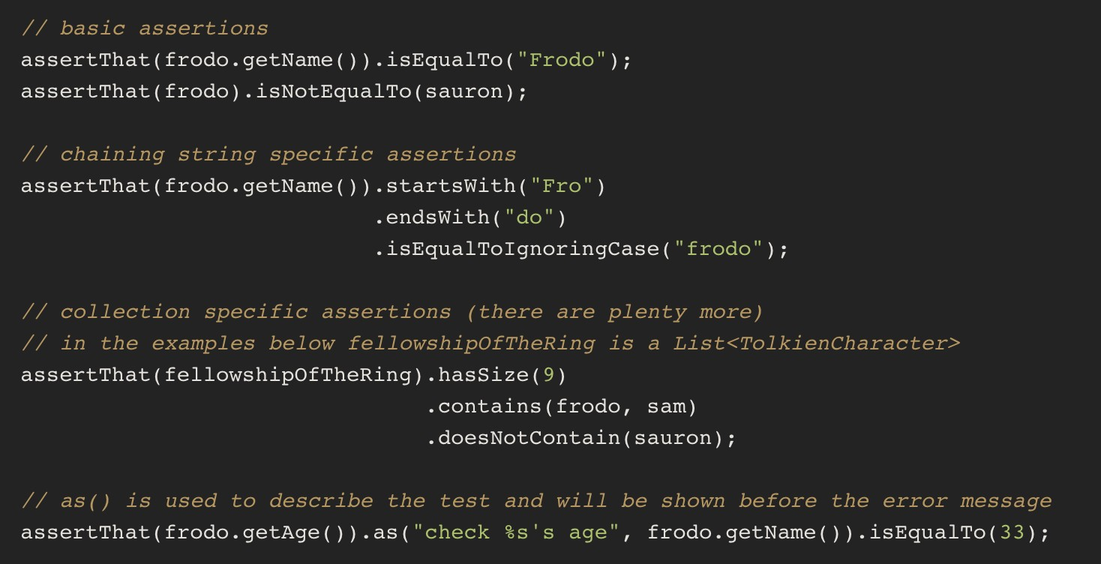
Steps to use AssertJ
import static org.assertj.core.api.Assertions.assertThat;

Slide 16
Why I use AssertJ?
Easy to learn: Quick start
Easy to use: you just need to add a dependency and static import in your test class to start using AssertJ.
Fluent APIs: AssertJ helps you to diversify your assertions.
More readable code auto-completion: AssertJ provides auto-completion in IDEs. So you don't need to remember all method names.

Slide 17
You can use JUnit 5 assertions
JUnit 5 assertAll
JUnit 5 assertArrayEquals
JUnit 5 assertEquals
JUnit 5 assertNotEquals
JUnit 5 assertNotSame
JUnit 5 assertNull and assertNotNull JUnit 5 assertSame
JUnit 5 assertThrows
JUnit 5 assertTimeout
JUnit 5 assertFalse
JUnit 5 assertTrue

Slide 18
@DataJpaTest annotation
Mr.AMITAVA CHATTERJEE

Slide 20
@DataJpaTest annotation
Spring Boot provides the @DataJpaTest annotation to test the persistence layer components that will autoconfigure in-memory embedded database for testing purposes.
The @DataJpaTest annotation doesn’t load other Spring beans (@Components, @Controller, @Service, and annotated beans) into ApplicationContext.
By default, it scans for @Entity classes and configures Spring Data JPA repositories annotated with @Repository annotation
By default, tests annotated with @DataJpaTest are transactional and roll back at the end of each test.

Slide 21
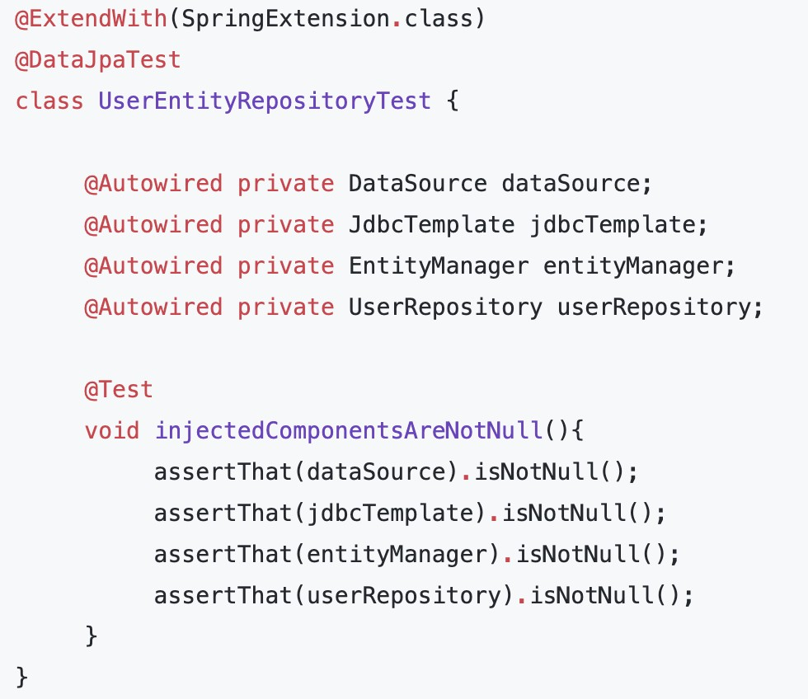
@DataJpaTest annotation
To test Spring Data JPA repositories or any other JPA-related components for that matter, Spring Boot provides the @DataJpaTest annotation.

Slide 22
Spring Boot Application Repository Layer Testing
Mr. AMITAVA CHATTERJEE

Slide 23


















Spring Boot Application Repository Layer Testing
Service Layer
Controller Layer
Repository Layer
DB
@DataJpaTest
Mockito

Slide 24
Repository Testing
1.Overview of @DataJpaTest annotation 2.Unit test for save employee operation 3.Unit test for get all employees operation 4.Unit test for get employee by id operation
5.Unit test for get employee by email operation (custom query) 6.Unit test for update employee operation
Unit test for delete employee operation
Unit test for custom query using JPQL with index parameters (using @Query annotation) 9.Unit test for custom query using JPQL with named parameters (using @Query annotation) 10.Unit test for custom Native query with index parameters (using @Query annotation) 11.Unit test for custom Native query with Named parameters (using @Query annotation) 12.Refactoring JUnit tests to use @BeforeEach annotation

Slide 25






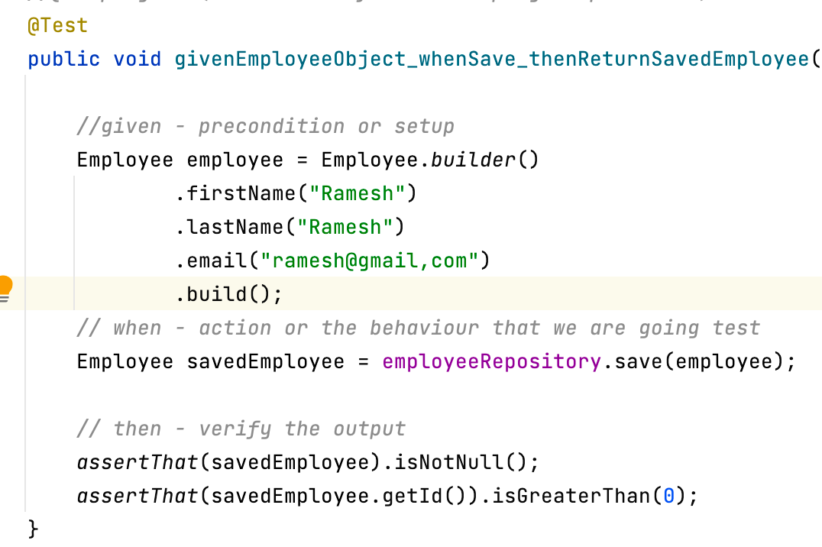





JUnit tests in BDD Style
Syntax
Example
@Test
public void given_when_then() {
// given - precondition or setup
// when - action or the behaviour we’re testing
// then - verify the output
}

Slide 26
Spring Boot Application Service Layer Testing
Mr.AMITAVA CHATTERJEE

Slide 27







Spring Boot Application Service Layer Testing
Service Layer
Repository Layer
Controller Layer
DB
Mockito

Slide 28
Service Layer Testing
1.Create EmployeeService with saveEmployee method 2.Quick Recap of Mockito basics (before writing Unit tests) 3.Unit test for EmployeeService saveEmployee method
Using @Mock and @InjectMocks annotations to mock the object
Unit test for saveEmployee method which throws Exception
Unit test for EmployeeService getAllEmployees method - Positive Scenario 7.Unit test for EmployeeService getAllEmployees method - Negative Scenario 8.Unit test for EmployeeService getEmployeeById method
Unit test for EmployeeService updateEmployee method
Unit test for EmployeeService deleteEmployee method

Slide 29





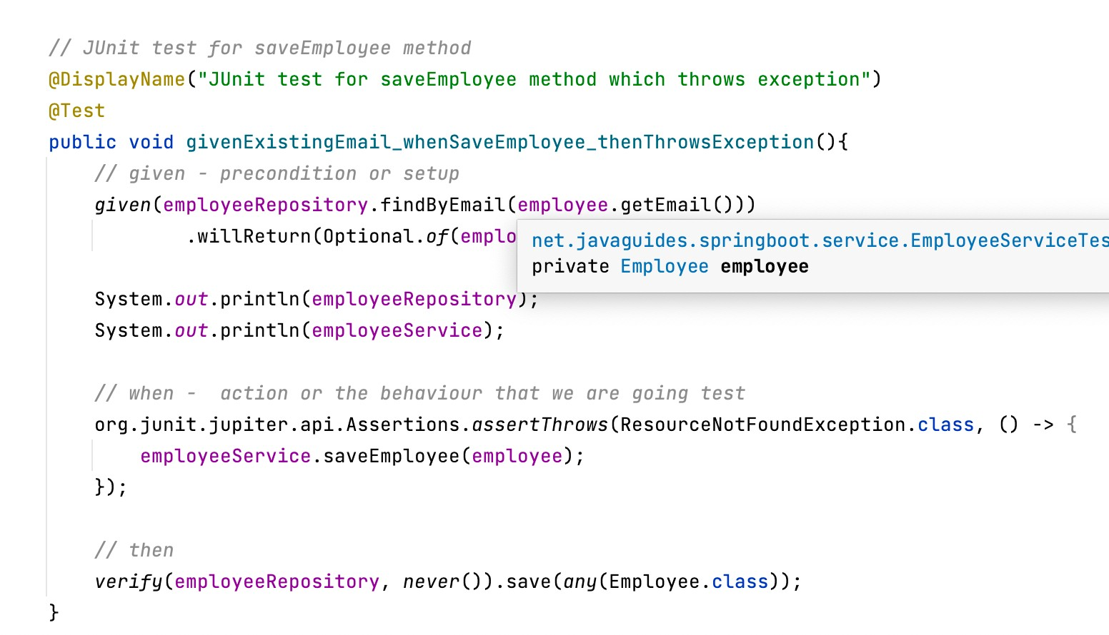





JUnit tests in BDD Style
Syntax
Example
@Test
public void given_when_then() {
// given - precondition or setup
// when - action or the behaviour we’re testing
// then - verify the output
}

Slide 30
Spring Boot Application Controller Layer Testing
Mr.AMITAVA CHATTERJEE

Slide 31






Spring Boot Application Controller Layer Testing
Repository Layer
Controller Layer
Service Layer
DB
Mockito
@WebMvcTest

Slide 32
Controller Layer Testing
@MockMvcTest Annotation
Build createEmployee REST API 3.Unit test createEmployee REST API 4.Build GetAllEmployees REST API 5.Unit test GetAllEmployees REST API
Refactoring JUnit test to use static imports
Build getEmployeeById REST API
Unit test getEmployeeById REST API - Positive Scenario 9.Unit test getEmployeeById REST API - Negative Scenario 10.Build updateEmployee REST API
11.Unit test updateEmployee REST API - Positive Scenario 12.Unit test updateEmployee REST API - Negative Scenario 13.Build deleteEmployee REST API
14.Unit test deleteEmployee REST API

Slide 33
Hamcrest Library
Hamcrest is the well-known framework used for unit testing in the Java ecosystem. It's bundled in JUnit and simply put, it uses existing predicates – called matcher classes – for making assertions.
Hamcrest is commonly used with JUnit and other testing frameworks for making assertions. Specifically, instead of using JUnit’s numerous assert methods, we only use the API's single assertThat statement with appropriate matchers.
Hamcrest is() method: If we want to verify that the expected value (or object) is equal to the actual value (or object), we have to create our Hamcrest matcher by invoking the is() method of the Matchers class.
Syntax:
assertThat(ACTUAL, is(EXPECTED));

Slide 34










JsonPath Library
A Java DSL for reading JSON documents.
JsonPath expressions always refer to a JSON structure in the same way as XPath expression are used in combination with an XML document. The "root member object" in JsonPath is always referred to as $ regardless if it is an object or array.
JSON
JsonPath Expressions
{
$ - root member of a JSON structure whether it is an object or array.
$.firstName = “Ramesh”
$.lastName = “Fadatare”
$.email = “ramesg@gmail.com”
"firstName": "Ramesh", “lastName": “Fadatare", “email": "ramesh@gmail.com"
}

Slide 35



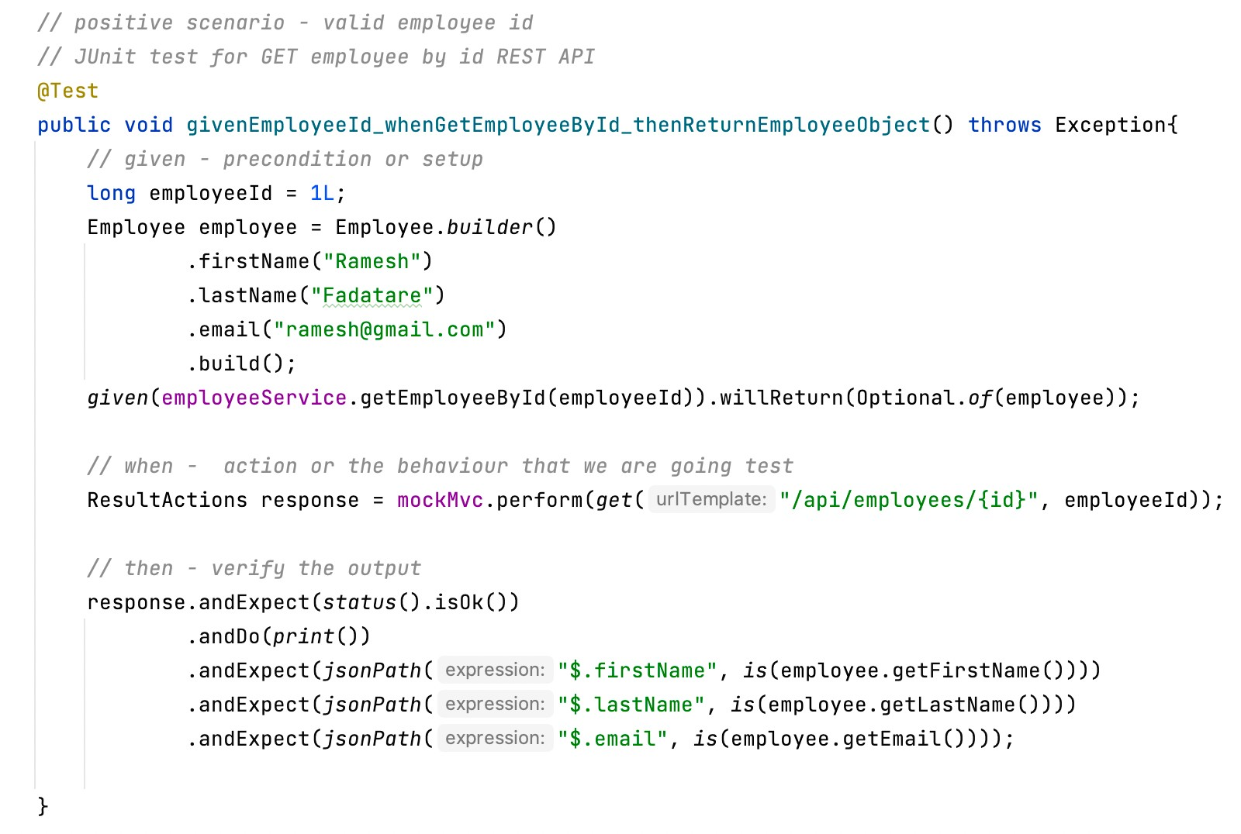

JUnit tests in BDD Style
Example
Syntax
@Test
public void given_when_then() {
// given - precondition or setup
// when - action or the behaviour we’re testing
// then - verify the output
}

Slide 36


























@WebMvcTest Annotation
SpringBoot provides @WebMvcTest annotation to test Spring MVC Controllers.
Also, @WebMvcTest based tests runs faster as it will load only the specified controller and its dependencies only without loading the entire application.
Spring Boot instantiates only the web layer rather than the whole application context. In an application with multiple controllers, you can even ask for only one to be instantiated by using, for example, @WebMvcTest(HomeController.class).
@WebMvcTest
Service Layer
Repository Layer
HomeController EmployeeController UserController
Controller Layer
DB

Slide 37







@WebMvcTest vs @SpringBootTest
Spring Boot provides @WebMvcTest annotation to test Spring MVC controllers. This annotation creates an application context that contains all the beans necessary for testing a Spring web controller.
Spring Boot provides @SpringBootTest annotation for Integration testing. This annotation creates an application context and loads full application context.
Unit testing - @WebMvcTest annotation Integration testing - @SpringBootTest
Service Layer
Repository Layer
HomeController EmployeeController UserController
Controller Layer
DB

Slide 38
Develop JUnit Tests in BDD Style using BBDMockito class
Mr.AMITAVA CHATTERJEE

Slide 39
Behavior-Driven development (BDD)
BDD encourages writing tests in a natural, human-readable language that focuses on the behavior of the application.
We write Unit Tests using a Behavior-Driven Development style (BDD) to increase the test readability (a lot).
It defines a clearly structured way of writing tests following three sections (Arrange, Act, Assert):
given some preconditions (Arrange)
when an action occurs (Act)
then verify the output (Assert)

Slide 40










Spring Boot Application Service Layer Testing
Service Layer
Repository Layer
Controller Layer
DB
Mockito

Slide 41


Spring Boot Application Service Layer Testing
Employee Service
Employee Repository
Employee Controller
DB
Mockito

Slide 42
Mocking Dependencies using Mockito
Mockito mock() method - We can use Mockito class mock() method to create a mock object of a given class or interface. This is the simplest way to mock an object.
Mockito @Mock Annotation - We can mock an object using @Mock annotation too. It’s useful when we want to use the mocked object at multiple places because we avoid calling mock() method multiple times. The code becomes more readable and we can specify mock object name that will be useful in case of errors.

Slide 43
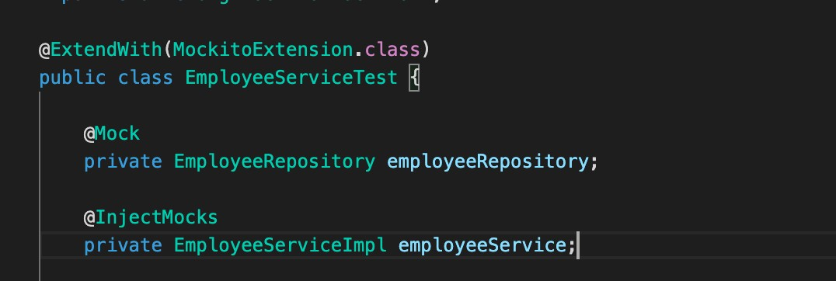
Mockito @InjectMocks Annotation
When we want to inject a mocked object into another mocked object, we can use @InjectMocks annotation. @InjectMock creates the mock object of the class and injects the mocks that are marked with the annotations @Mock into it.

Slide 44
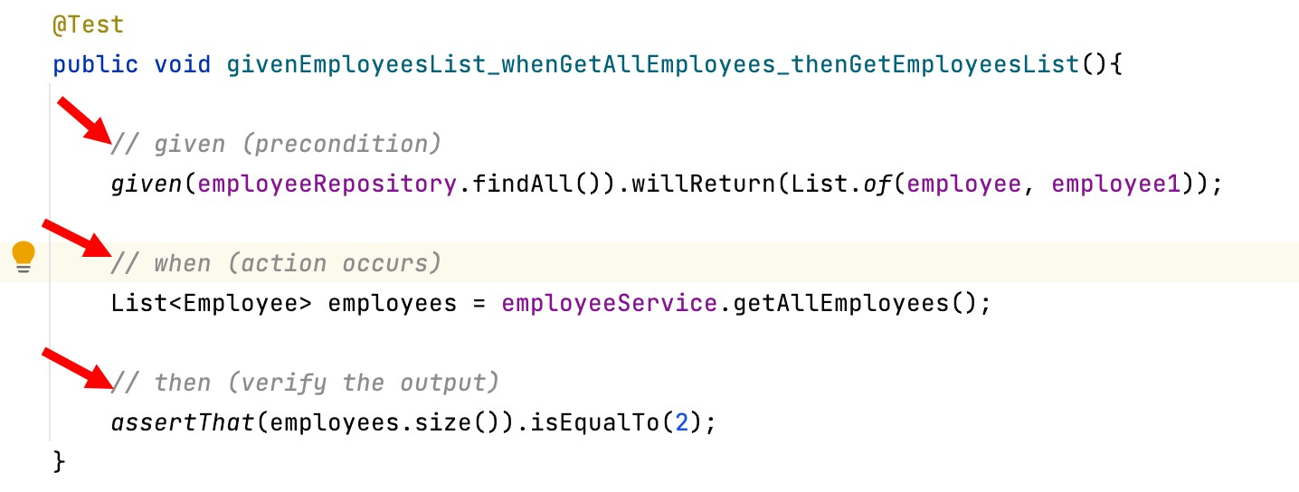
BDDMockito Class
The Mockito library is shipped with a BDDMockito class which introduces BDD-friendly APIs.
Example: BDD style writing tests uses //given //when //then comments

Slide 45
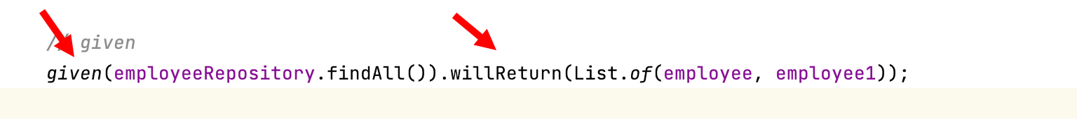
Mockito vs. BDDMockito
The traditional mocking in Mockito is performed using
when(obj).thenReturn() in the Arrange step.
This BDDMockito allows us to take a more BDD friendly approach arranging our tests using given().willReturn().

Slide 46
Steps to use BDDMockito API
1. Add static import statement
2. Use given().willReturn() method

Slide 47
Spring Boot Application Integration Testing
Mr.AMITAVA CHATTERJEE

Slide 48


Integration Testing
As the name suggests, integration tests focus on integrating different layers of the application. That also means no mocking is involved.
Basically, we write integration tests for testing a feature which may involve interaction with multiple components.
Employee Service
Employee Repository
Employee Controller
DB
Examples:
Employee Management Feature ( EmployeeRepository, EmployeeService, EmployeeController).
User Management Feature (UserController, UserService, and UserRepository).
Login Feature (LoginRespository, LoginController, Login Service) etc

Slide 49










Spring Boot Application Integration Testing
Service Layer
Repository Layer
Controller Layer
DB
@SpringBootTest
Mockito

Slide 50



Spring Boot Application Integration Testing
Service Layer
Repository Layer
Controller Layer
DB
@SpringBootTest
Mockito

Slide 51
Spring Boot Integration Testing
1.@SpringBootTest annotation overview 2.Integration test save employee feature 3.Integration test get all employees feature 4.Integration test get employee by id feature 5.Integration test update employee feature 6.Integration test delete employee feature

Slide 52







@SpringBootTest
Spring Boot provides @SpringBootTest annotation for Integration testing. This annotation creates an application context and loads full application context.
@SpringBootTest will bootstrap the full application context, which means we can @Autowire any bean that's picked up by component scanning into our test.
Integration testing - @SpringBootTest
Controller Layer
Service Layer
Repository Layer
DB

Slide 53
@SpringBootTest
It starts the embedded server, creates a web environment and then enables @Test methods to do integration testing.
By default, @SpringBootTest does not start a server. We need to add attribute webEnvironment to further refine how your tests run. It has several options:
★ MOCK(Default): Loads a web ApplicationContext and provides a mock web environment
★ RANDOM_PORT: Loads a WebServerApplicationContext and provides a real web environment. The embedded server is started and listen on a random port. This is the one should be used for the integration test
★ DEFINED_PORT: Loads a WebServerApplicationContext and provides a real web environment.
★ NONE: Loads an ApplicationContext by using SpringApplication but does not provide any web environment

Slide 54














Steps for Integration Testing
1. We will add MySQL driver dependency to our Spring boot application. Of course you can use h2 in-memory database for integration testing
Employee Service
Employee Repository
Employee Controller
MySQL
Add MySQL configuration in application.properties file
Write Integration tests for EmployeeController

